Slide 1
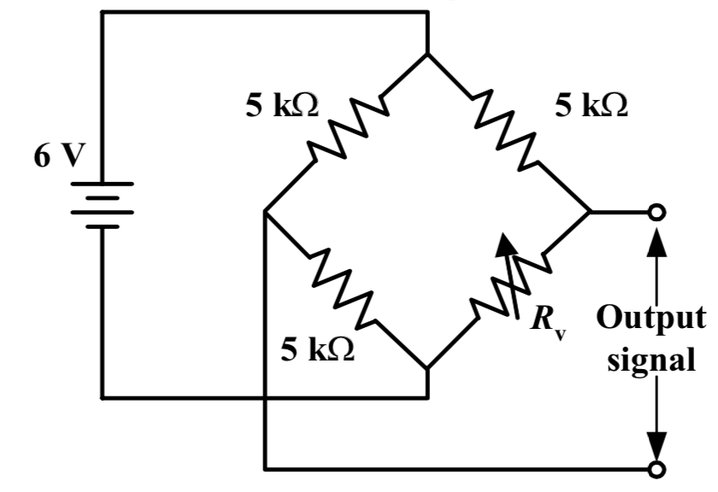



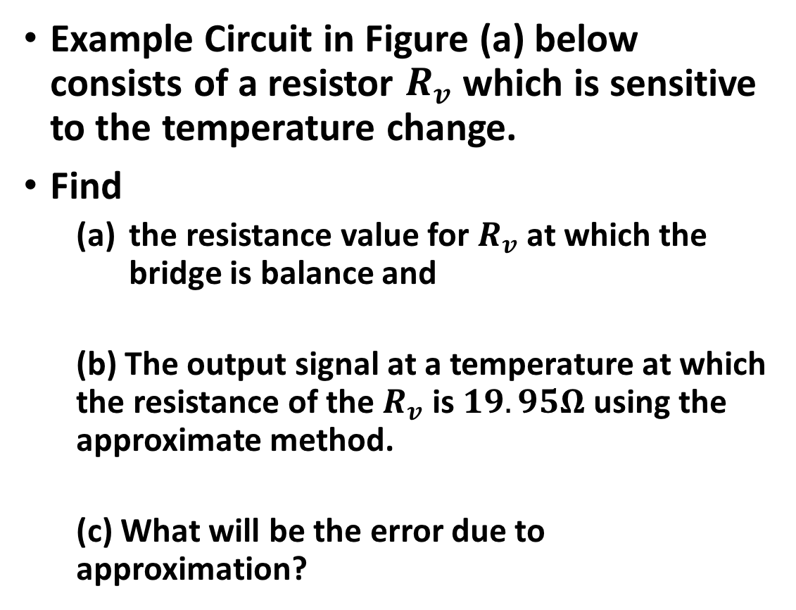
Quiz 3 (Computer) : 6 mins
Example Circuit in Figure (a) below consists of a resistor $R_{v}$ which is sensitive to the temperature change.
Find
the resistance value for $R_{v}$at which the bridge is balance and
(b) The output signal at a temperature at which the resistance of the $R_{v}$ is $19.95Ω$ using the approximate method.
(c) What will be the error due to approximation?
20 $Ω$
20 $Ω$
20 $Ω$

Slide 2
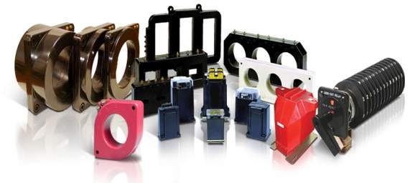
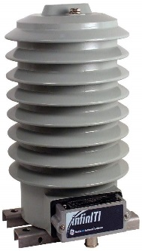
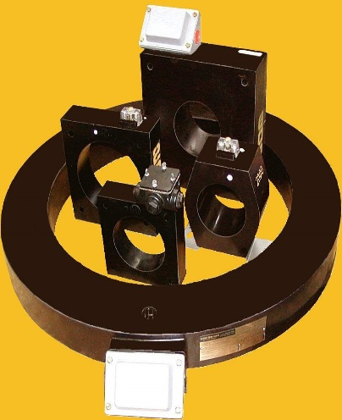
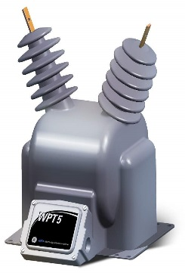
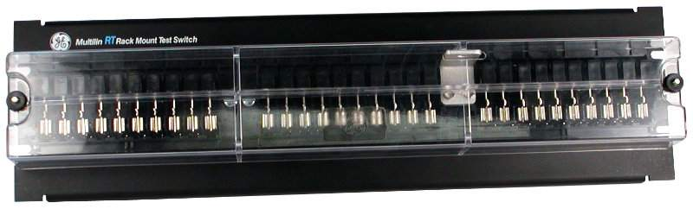
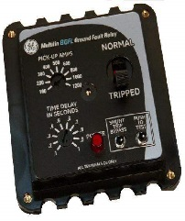
Instrument Transformers

Slide 3
Instrument Transformers
What is an Instrument Transformer ?:
It is a transformer that is used in conjunction with any measuring instrument (i.e., Ammeter, Voltmeter, Wattmeter, Watt-hour-meter, …etc.)or protective equipment (i.e., Relays).
It utilizes the current-transformation and voltage transformation properties to measure high ac current and voltage.

Slide 4
Instrument Transformers
Types of instrument transformers :
These instrument transformers are of two types:-
Current transformers
Potential transformers

Slide 5
Instrument Transformers
Applications of Instrument Transformers:
For measurement of high ac current, it is usual to use low range ac ammeter with suitable shunt.
For measurement of high ac voltage, low range ac voltmeters are used with high resistances connected in series.
For measurement of very high ac current and voltage, we cannot use these methods. Instead, we use specially constructed HV instrument transformers to isolate the high voltage circuit from the measuring circuit in order to protect the measuring instruments from burning.

Slide 6
Instrument Transformers
Application of Instrumentation Transformers In dc circuits for current and voltage measurement, we use low range dc ammeters and voltmeters with rectifiers connected in their secondary circuits.
The vast primary application of Instrument Transformers is for the protection and control of power system and power equipment of high and very high ratings.
The working of these instrument transformers are similar to those of the ordinary transformers.

Slide 7
Instrument Transformers
Basic Construction and Magnetic Circuit of Instrument Transformers

Slide 8
Instrument Transformers
Polarity of Instrument Transformers

Slide 9
Instrument Transformers
Common connections of instrument transformers

Slide 10
Current Transformers
What is current Transformer (CT)?:
A current transformer is a transformer, which produces in its secondary winding low current, which is proportional to the high current flowing in its primary winding.
The secondary current is usually much smaller in magnitude than the primary current.
The design of CT depends on which type of instrument is connected to its secondary winding. Measuring instrument OR Protective instrument.
-Measuring instrument CT is expected to give accurate results up to a maximum of 125% of its normal full-load rated current.
-Protective instrument CT is expected to be accurate for up to 20 times of its normal full-load rated.
Based on the type of equipment for which the Ct is used for, its saturation point will vary. At the same time it is expected to be linear in the entire working range.

Slide 11
Current Transformers
Construction of C.T.:
C.T. has a primary coil of one or more turns made of thick wire connected in series with the line whose current is to be measured.
The secondary consists of a large number of turns made of fine wire and is connected across an ammeter or a relay’s terminals.

Slide 12
Construction Types of Current Transformers
Window-type
Bar-type

Slide 13
Current Transformers
Function of CT:
The principal function of a CT is to produce a proportional current at a level of magnitude, which is suitable for the operation of low-range measuring or protective devices such as indicating or recording instruments and relays.
The primary and secondary currents are expressed as a ratio such as 100/5 or 1000/5 .
With a 100/5 ratio CT, 100A flowing in the primary winding will result in 5A flowing in the secondary winding, provided that the correct rated burden is connected to the secondary winding.

Slide 14
Current Transformers
“Class” of a CT:
The extent to which the actual secondary current magnitude differs from the calculated value, expected by the virtue of the CT ratio, is defined as the accuracy “Class” of the CT.
The greater the number used to define the class, the greater the permissible “current error” [the deviation in the actual secondary current from the calculated value].

Slide 15
Current Transformers
Specifications of CT:
CTs should be specified as follow:
RATIO : Input / output current ratio
VA: Total burden (rating) including pilot wires.
Common burden ratings are 2.5, 5, 10, 15 and 30 VA. For example:
Moving iron ammeter is 1-2 VA
Moving coil rectifier ammeter is 1-2.5 VA
Electro-dynamic instrument is 2.5-5 VA
Maximum demand ammeter is 3-6 VA
Recording ammeter or transducer is 1-2.5 VA

Slide 16
Current Transformers
CLASS : The accuracy required for the operation
BURDEN (OHMIC): (Depending on pilot lead length)

Slide 17
Current Transformers
Current Transformers Stepping:
These are used with low range ammeters to measure current in high voltage alternating circuits where it is not practical to connect instrument and meters directly to lines.
They are step-up transformers (voltage ratio) because when we step-up the voltage the current decreases.
The current is step-down in a known ratio called the current ratio .

Slide 18
Connections of Current Transformers
Single-Ratio CT
Multi-Ratio CT

Slide 19
Multi-ratio CT:
As indicated in the previous Figure, current transformers having a center tapped secondary are referred to as a dual ratio CT.
Dual ratio CT are used in applications where it is necessary to have available two ratios of primary to secondary current from the same secondary winding of the CT.
This may be accomplished by adding a tap in the secondary winding to get a second ratio.
The ratio obtained by the tap is usually one-half the ratio obtained by the full secondary winding.
A schematic example is previously shown with 200 amperes flowing in the primary, a connection X2 – X3 will produce 5 amperes out of the secondary. As the load grows to 400 amperes, the secondary circuit will be reconnected to X1 – X3 to still produce 5 amperes in the secondary circuit.

Slide 20
Current Transformers
Working (Measurement):
If a current transformer has primary to secondary current ratio of 100:5 then it steps up the voltage 20 times and step down the current 1/20 times of its actual value.
If we know the current ratio and the reading of an a.c. ammeter, the primary current can be calculated as:
Primary Current = CT ratio × ammeter reading

Slide 21
Current Transformers
Why CT secondary should never be open ?:
Ammeter resistance is very low ,the current transformer normally works as a short-circuited instrument.
If for any reason the ammeter is taken out of secondary winding then the secondary winding must be short-circuited with the help of a short-circuit switch.
If this is not done, then a high m.m.f. (Ampere-turns IT) will set up a high flux in the magnetic core and it will produce excessive core loss which produce heat and high voltage across the secondary terminals .
The high voltage can damage any electronic components in secondary side.
Hence the secondary of any current transformer should never be left open.

Slide 22
Construction of the DOUGHNUT Type C.T. :
The most common type of C.T. construction is the “DOUGHNUT” type. It is constructed of an iron toroid, which forms the core of the transformer, and is wound with many secondary turns.
Secondary Winding
Primary Conductor
Iron Core

Slide 23
The `doughnut' fits over the primary conductor, which constitutes one primary turn. If the toroid is wound with 240 secondary turns, then the ratio of the C.T. is 240 : 1 or 1200 : 5A
The continuous rating of the secondary winding is normally 5 AMPS in North America, and 1 AMP or 0.5 AMP in many other parts of the world.
This type of `doughnut' C.T. is most commonly used in circuit breakers and power transformers. The C.T. fits into the bushing, and the porcelain bushing fits through the centre of the `doughnut'.
Up to four C.T.'s of this type can be installed around each bushing of an oil circuit breaker. This arrangement is shown in a following diagram.

Slide 24
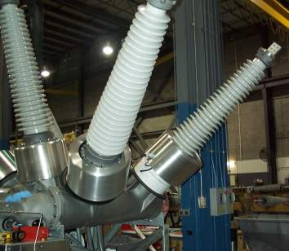
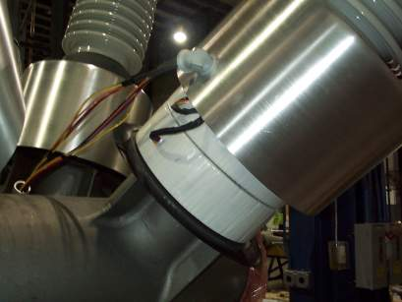
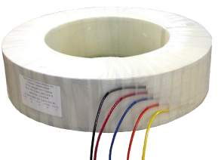
Substation Class Circuit Breakers' CTs
Polyester Taped Bushing CT on
Outdoor Circuit Breaker

Slide 25
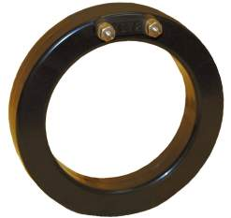
CT Turns-ratio (TR)
Primary Current
Secondary Current
Transformer Ratio =
_____________________
Primary Current
(100 amps)
Secondary Current
(5 amps)
100
5
___
= 100:5 or 20:1

Slide 26
Polarity
Direction of
Secondary Current
Direction of
Primary Current
Secondary
Polarity
Marks
X1
IEEE
S1
IEC
Primary
Polarity
Marks
IEEE
H1
IEC
P1
Primary current into “polarity” forces
Secondary current out of “polarity”

Slide 27
Polarity
Direction of
Secondary Current
Secondary
Polarity
Marks
X1
IEEE
S1
IEC
Primary
Polarity
Marks
IEEE
H1
IEC
P1
Direction of
Primary Current
Primary current into “non-polarity” forces
Secondary current out of “non-polarity”

Slide 28
CT Metering Accuracy
=
Since actual secondary current
Rated secondary current
Then:
The difference in % is known as the “Accuracy” or “Class”
of the CT

Slide 29
Burden
Load connected to CT secondary
Includes devices & connecting leads
Expressed in ohms
Standard values = B0.1, B0.2, B0.5, B0.9, B1.8
E0.04, E0.2

Slide 30
CT accurate Burden Calculation
Z_{T} = R_{CT} + R_{L} + Z_{B}
Z_{T} = Total burden in ohms (vector summation of
resistance and inductance components)
R_{CT} = CT secondary resistance in ohms @75 deg C
R_{L} = Resistance of leads in ohms (Total loop distance)
Z_{B} = Device impedance in ohms

Slide 31
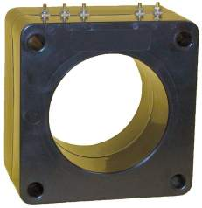
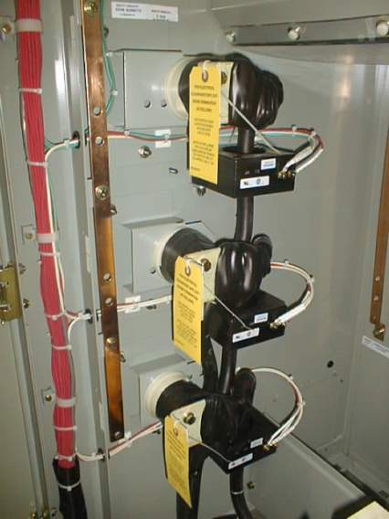
CT Actual Connections
Typical window CT

Slide 32
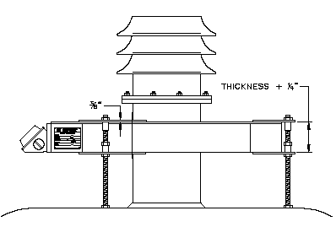
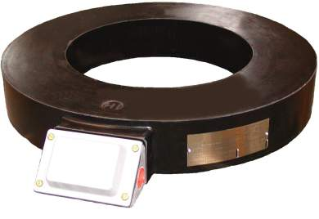
Power Transformers’ CT Connections
Slip over current transformer for installation over exterior of outdoor bushing
Outdoor Type BO7 for Retrofit

Slide 33
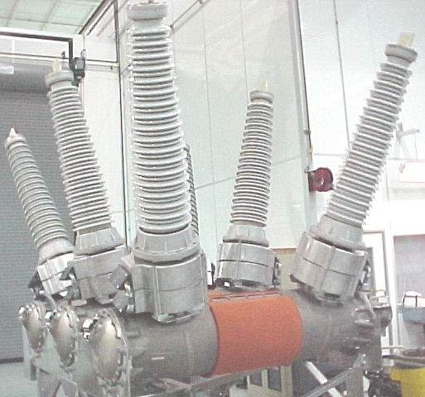
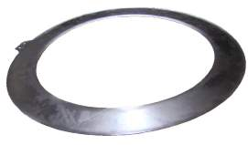
Substation Class Circuit Breakers’ CT’s
Ground Shield
Outdoor BO7 - Replaces BCT’s in shielded aluminum housing

Slide 34
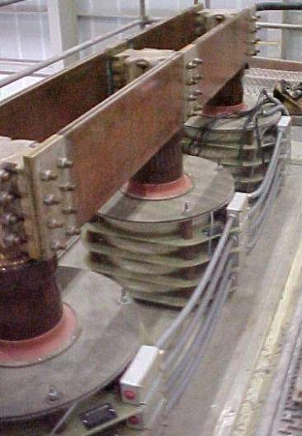
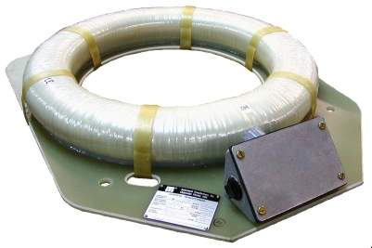
Generators CT Connections
Board Mounted Generator CT

Slide 35
Potential Transformers
What is a Potential Transformer (PT) or (VT)?:
A PT or sometimes called VT is a step-down transformer having many primary turns but few secondary turns.
In a step-down transformer the voltage decreases and the current increases, thus voltage can be easily measured by using a low-range voltmeter instrument.
The voltage is stepped-down in a known ratio called the voltage ratio.

Slide 36
Potential Transformers
Construction and working of P.T.:
Construction
A potential transformer has many primary winding turns but few number of secondary winding turns that makes it a step-down transformer.
A Voltmeter is connected to the secondary winding is usually a voltmeter of 150 V.
Working (Measurement):
Primary terminals are connected in parallel across the line to which the voltage is to be measured.
The voltmeter reading gives the transformed value of the voltage across the secondary terminals.
The deflection of the voltmeter when divided by the transformed ratio gives the actual voltage across the primary winding as:
The Line voltage = deflection / transformation-Ratio
Where transformation ratio = V2/V1

Slide 37
Potential Transformers
Precaution for P.T.:
Since the secondary of a p.t. is connected to relays, their ratings are usually 40 to 100 Watts.
For safety purpose the secondary should be completely insulated from the high voltage primary and should be in addition grounded.

Slide 38
Potential Transformers
Types of P.T. :
Some types of p.t. are:
Shell type
Dry type
Oil type
Rating Type
Below 5000 v Shell type
5000-13800 v Dry type and oil type
Above 13800 v only oil type

Slide 39
Potential Transformer Ratios
VP
14,400/120 = 120/1
4200/120 = 35/1
2400/120 = 20/1
Vs
Relay

Slide 40
Connections of 1-Phase Potential Transformers

Slide 41
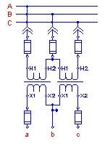
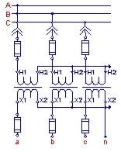
Other PT and 3-Phase Typical Connections
Open Delta Connection
(2) Double Bushing VTs
Y – Y Connection
(3) Single Bushing VTs

Slide 42
Basic important rules for Instrument Transformers
Rule # 1
Never open circuit a current
transformer secondary while the primary is energized
CTs are intended to be proportional current devices. Very high voltages can result from open circuiting the secondary circuit of an energized CT. Even very small primary currents can cause damage.

Slide 43
Rule # 2
Never short circuit the secondary of an energized VT
VTs are intended to be used as proportional voltage
devices. Damaging current will result from short
circuiting the secondary circuit of an energized VT.

Slide 44
Rule # 3
CT secondary leads must be added to the CT burden
Electronic relays usually represent very little burden to the CT secondary circuit. In many cases the major burden is caused by the CT secondary leads.

Slide 45
Rule # 4
Never use a 60 Hz rated VT
on a 50 Hz System
60 Hz VTs may saturate at lower frequencies and exceed temperature limitations. VT failure is likely…severe equipment damage is possible.

